Slide 1

Introduction to CLARIN
Francesca Frontini, Giulia Pedonese and Iulianna van der Lek
20 September 2024
FAIR-by-Design Training for CLARIN Community

Slide 2

CLARIN in 8 Bullets
‘Common Language Resources and Technology Infrastructure’
ESFRI roadmap (2006), ESFRI ERIC status (2012), Landmark (2016)
Easy and sustainable access for scholars in Social Sciences and Humanities (SSH):
digital language data (written, spoken, video or multimodal)
tools to discover, analyse, combine data wherever they are located
single sign-on environment (you all can get an account)
Ecosystem for knowledge exchange
Some services integrated in EOSC
https://www.clarin.eu/content/clarin-nutshell

Slide 3
CLARIN for Open Science
Promotion of sharing & re-use of language data through sustainable data registries
Enhancement & deployment of interoperability of language data & services
common metadata framework
distributed network of FAIR certified data repositories for language data
Promotion of
comparative perspectives
multidisciplinary collaboration
transnational research
responsible data science
Support for linguistic diversity
data covering many languages
tools for many languages
language resources in all modalities
discipline- & language-agnostic

Slide 4

FAIR Principles
Findable
Persistent Identifiers (PIDs)
Data Management Plan
Metadata
Licences
Repositories
Accessible
Interoperable
Reusable

Slide 5

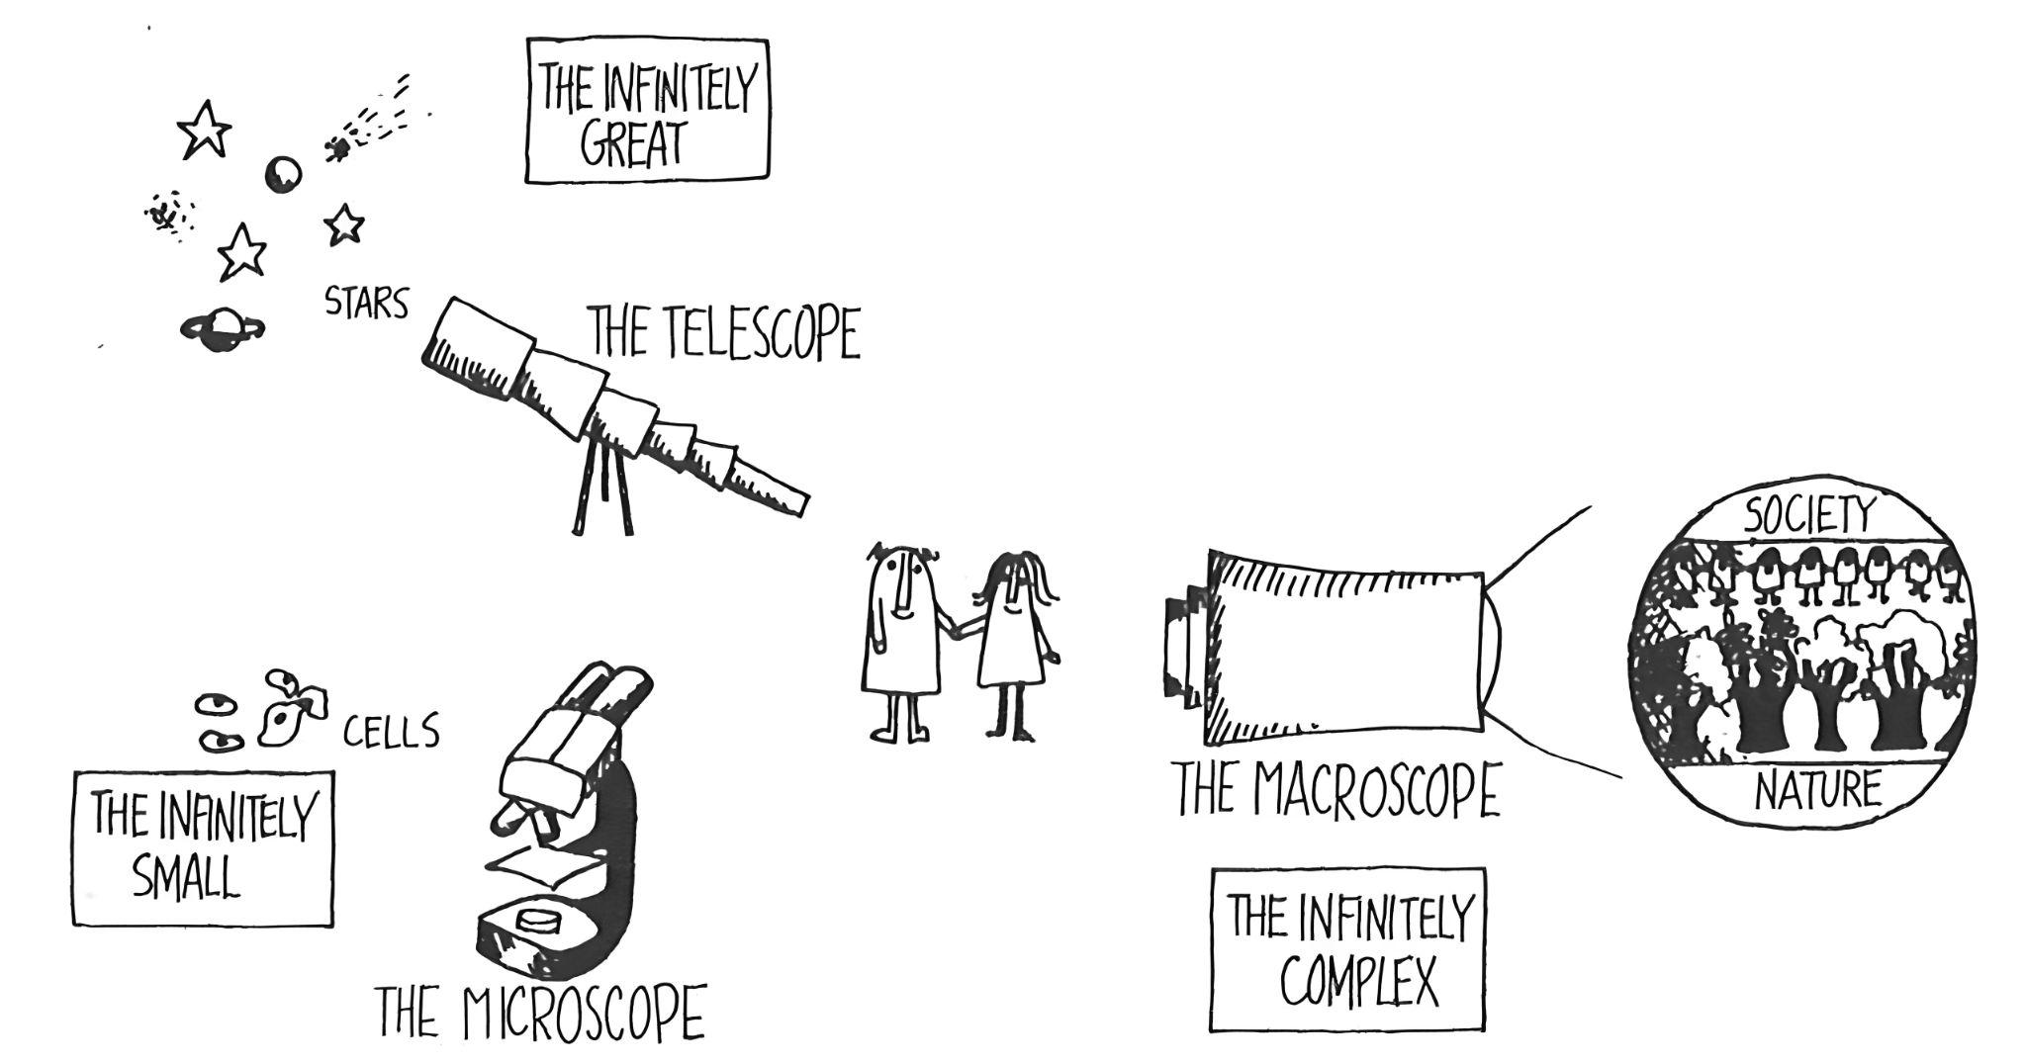
CLARIN’s Macroscope Potential
Source: Rosnay, 1979

Slide 6
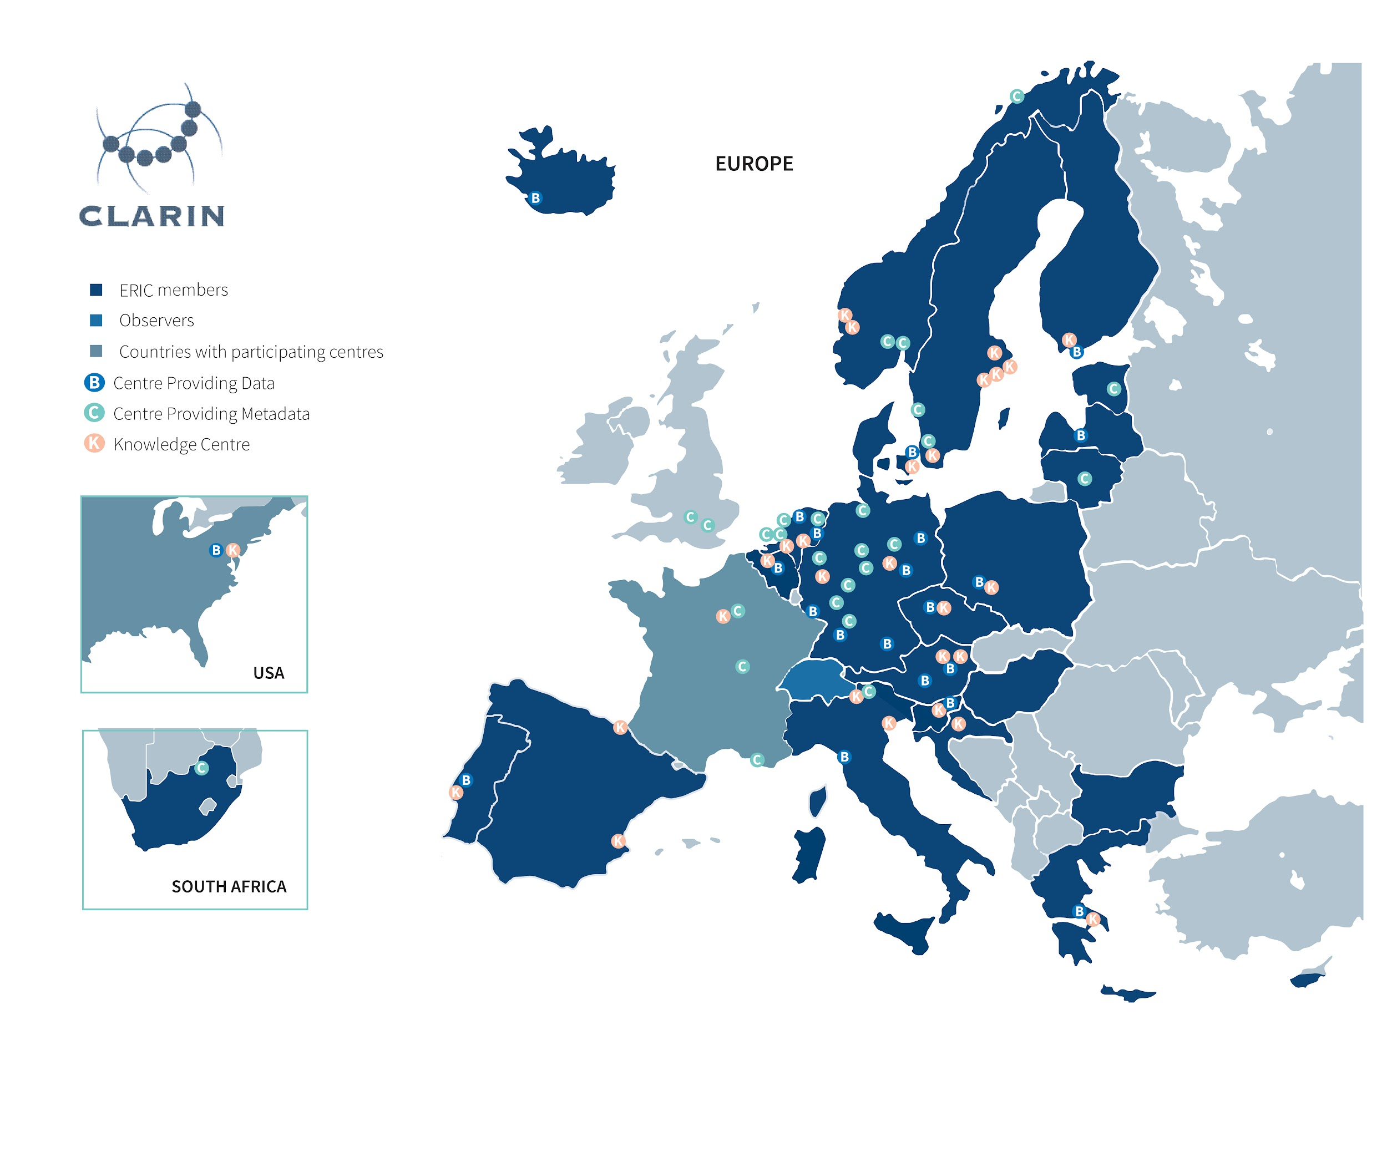
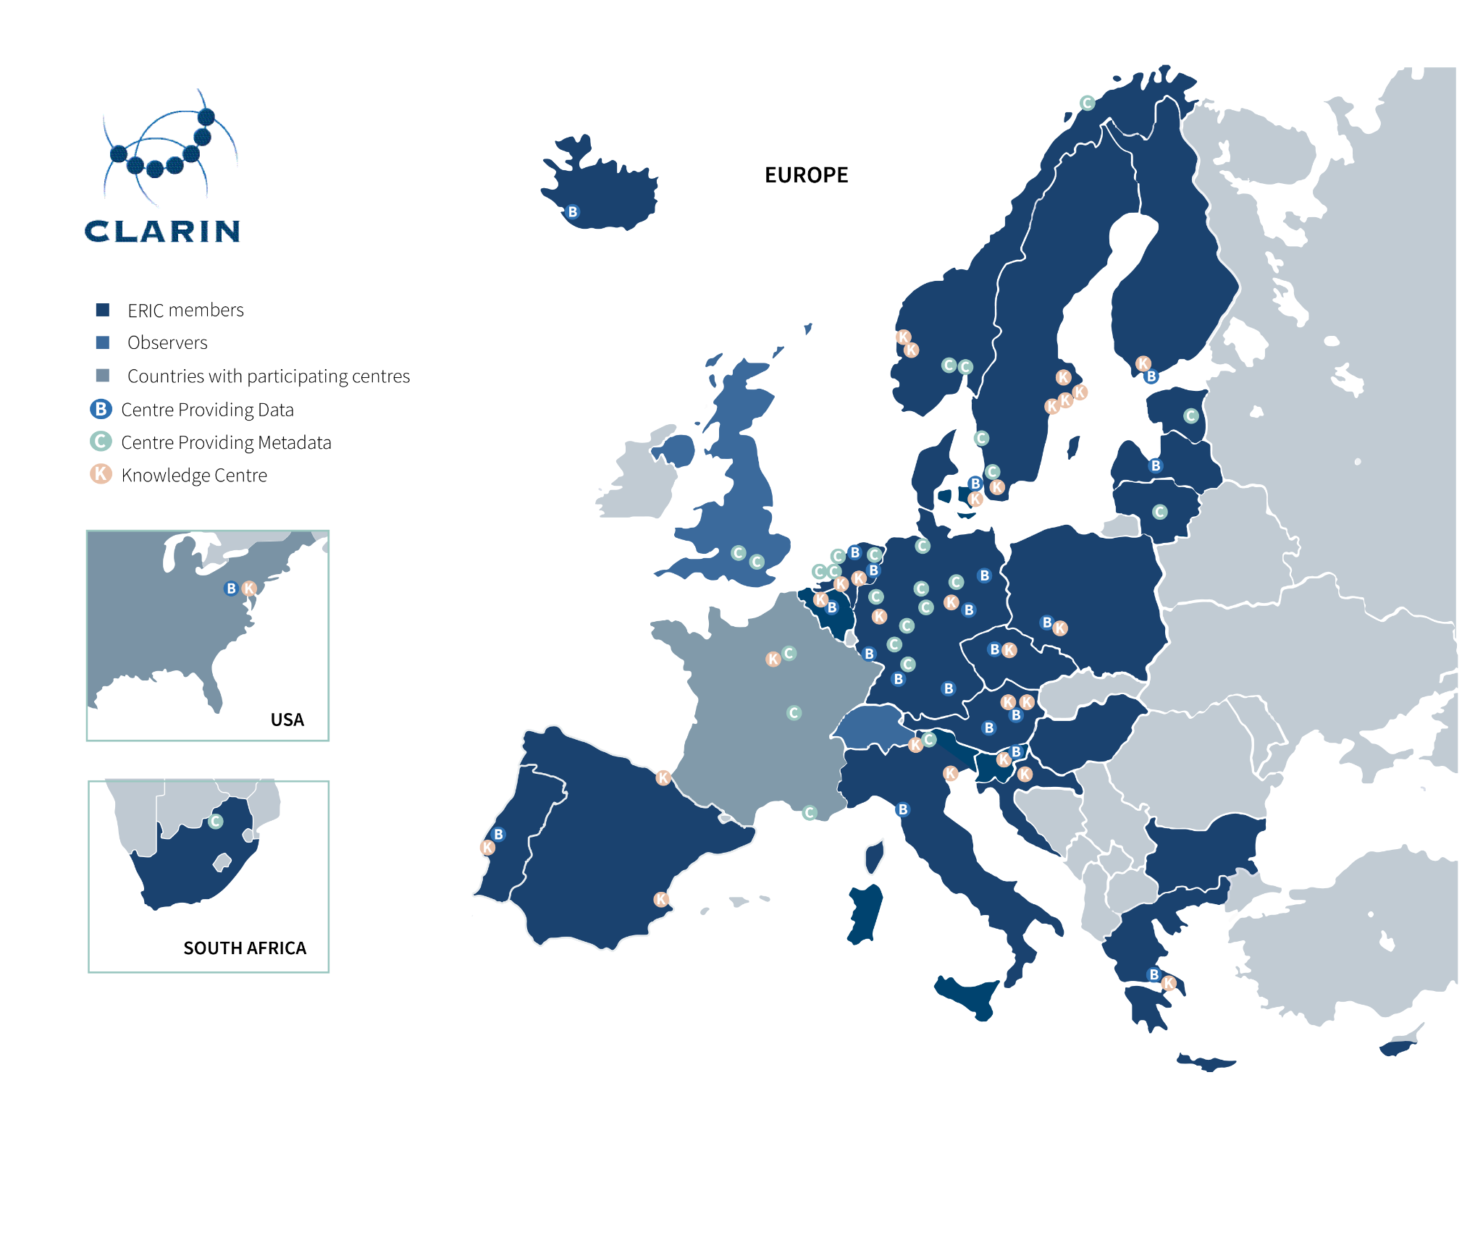
CLARIN’s Countries (Sept 2024)
A consortium of type ERIC:
24 members and 2 observers
https://www.clarin.eu/content/national-consortia

Slide 7


CLARIN’s Centres (Sept 2024)
A distributed network of 70 centres:
22 CTS certified data centres (B-centres)
Strong focus on FAIRness & interoperability
Federated login
Central metadata harvesting for easy discovery
Chained services
30 Knowledge centres (K-centres)
https://www.clarin.eu/content/clarin-centres

Slide 8
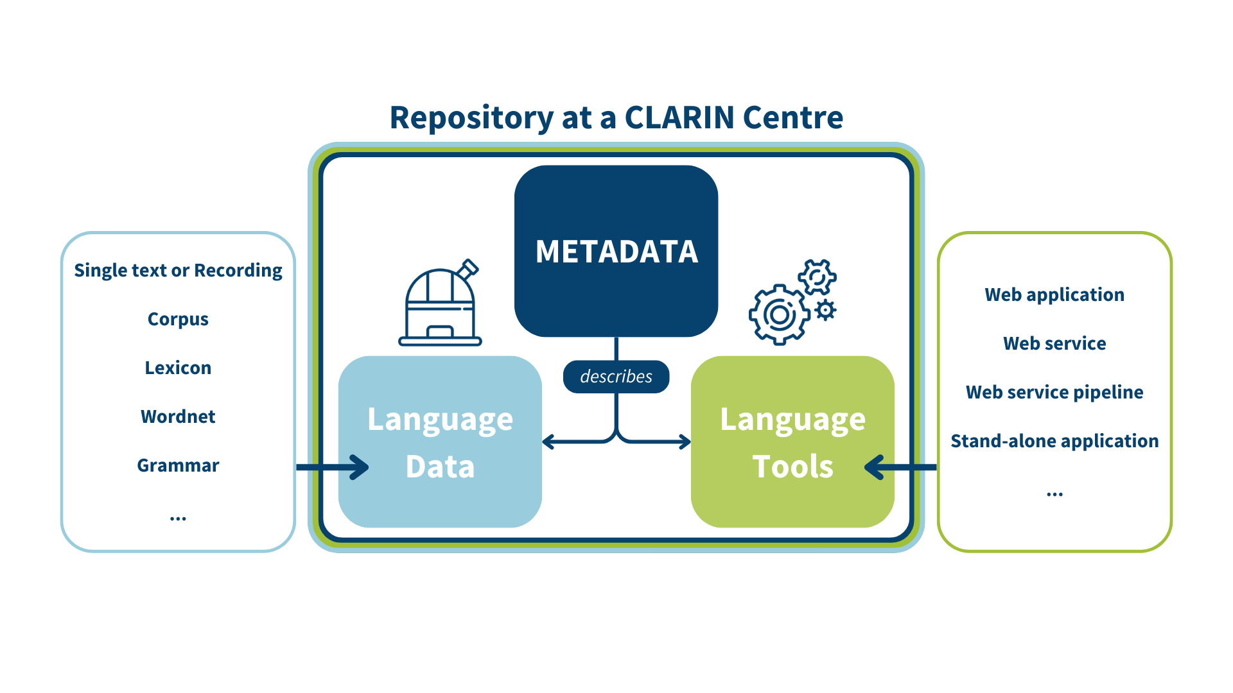
How CLARIN Works

Slide 9

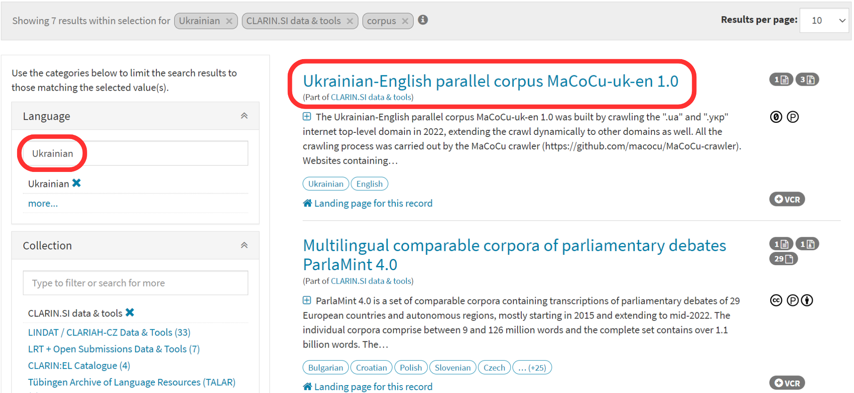

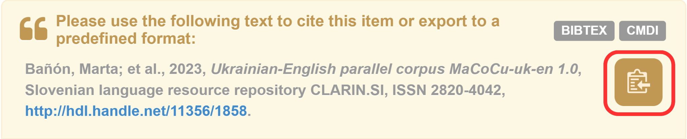
Virtual Language Observatory
Facet search
Links to landing pages
Download options
Details on licences
Details on technical features
Overview of tools that match the data
Citing LRs:
https://vlo.clarin.eu

Slide 10

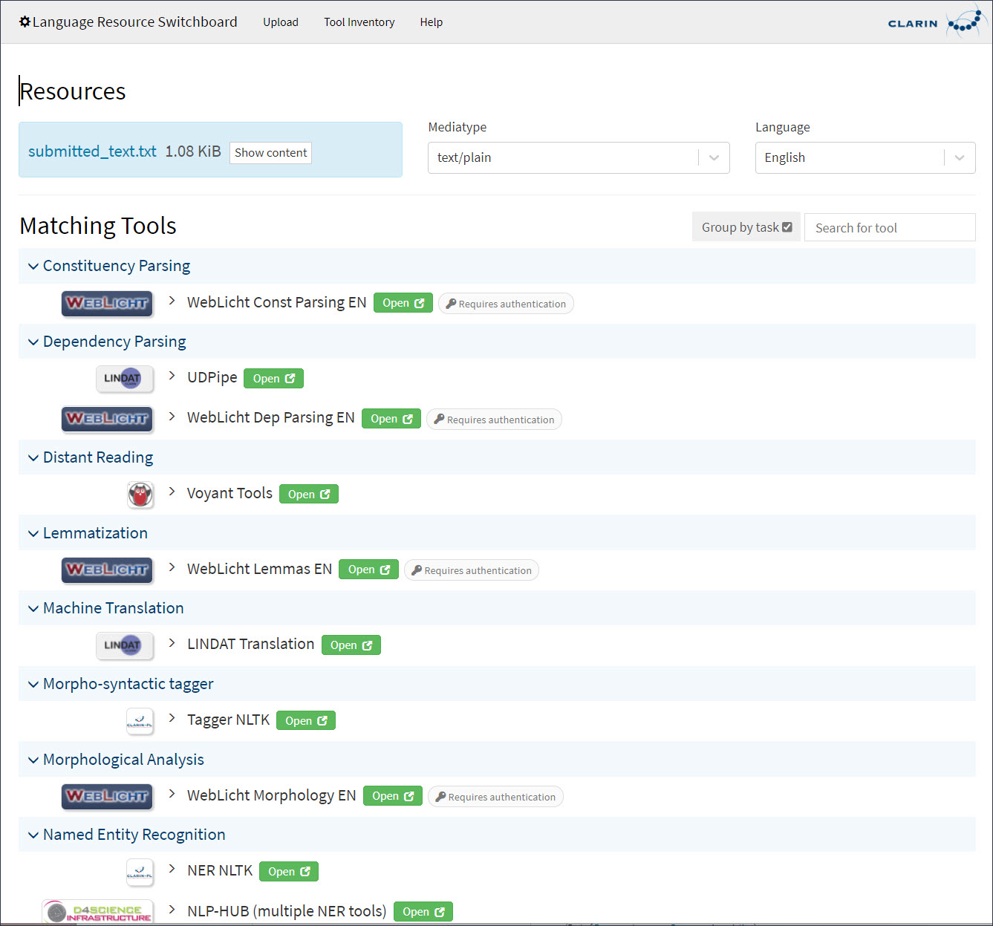
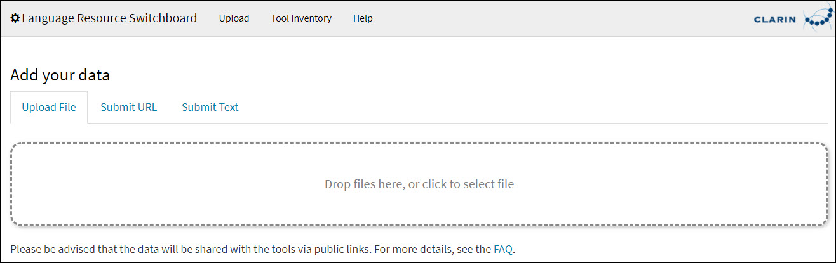
Language Resource Switchboard
Upload a text to find a matching tool for NLP tasks. It can be accessed directly from the VLO.
https://switchboard.clarin.eu/

Slide 11
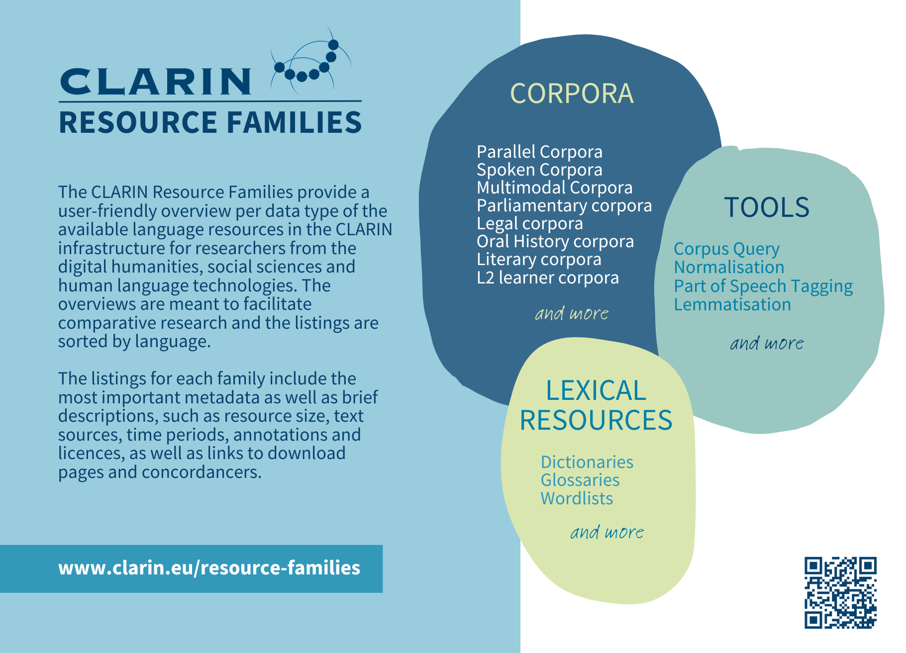
CLARIN Resource Families
https://www.clarin.eu/resource-families

Slide 12
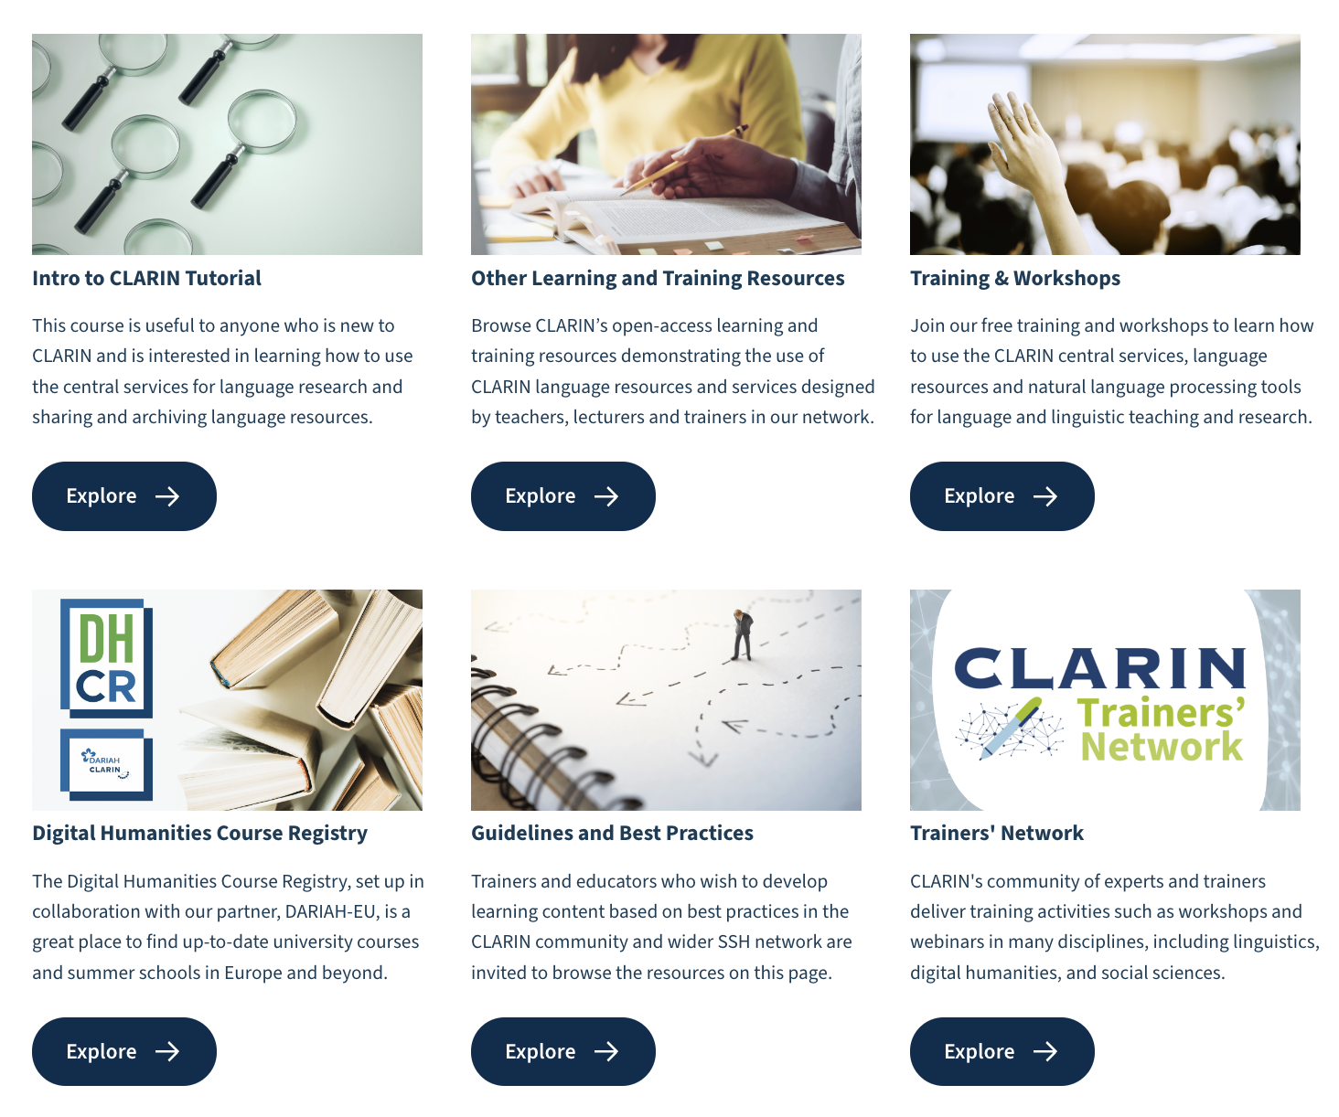
CLARIN Learning Hub
https://www.clarin.eu/content/learning-hub

Slide 13

CLARIN Learning Hub
2022: We started thinking about FAIR Training when collecting materials from the CLARIN community via the Teaching with CLARIN call.
Got involved in various task forces debating on the topic, e.g. Open AIRE Community of Practice for training coordinators, ELIXIR FAIR Training, EOSC OA Working Group on Training
In 2023 we noticed the Skills4EOSC FAIR-by-Design method and proposed to adapt it for CLARIN at the CLARIN Bazaar 2023.
https://www.clarin.eu/content/learning-hub

Slide 14







Learn More

Slide 15

Thank You!
www.clarin.eu
clarin@clarin.eu

